Slide 1

Long Tail Recommendations using Amazon Product Reviews
Team Pandas

Slide 2

Table of Contents:
Big Picture Scope
Motivation
Data Description
Methods Proposed
Specific Experiments / Analyses Proposed
Mock-up or Preliminary Results
Team Work
Summary
Conclusion
https://reviewediting.files.wordpress.com/2012/07/contents.jpg

Slide 3
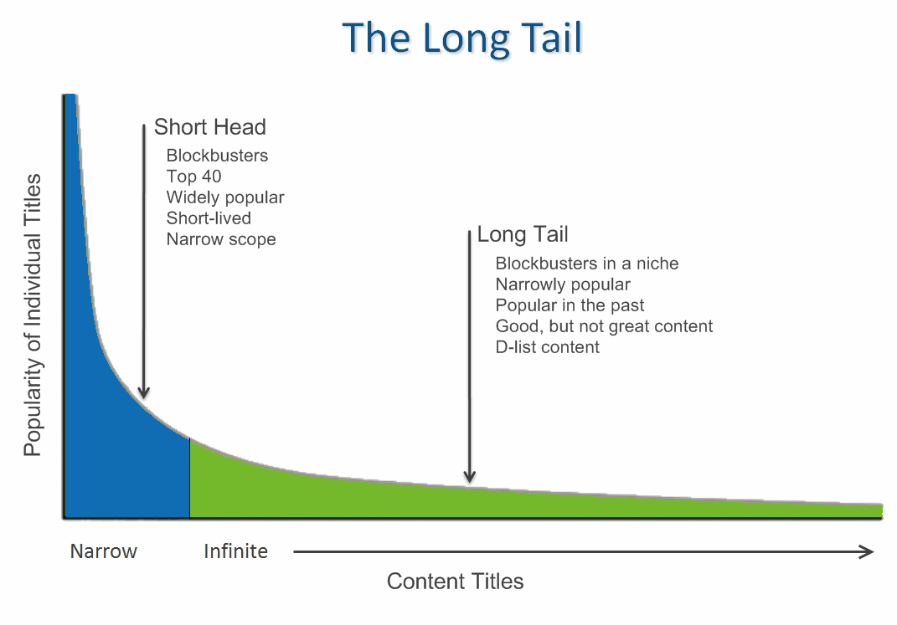
Big Picture Scope :
[1]
[1] https://www.learningsolutionsmag.com/articles/154/e-learnings-long-tail-leaving-walmart-to-buy-from-amazon

Slide 4

Big Picture Scope cont’d :
The main problem statement is boosting recommendations in the long tail of the Amazon product dataset.
[2] https://jeldridgedotcom.files.wordpress.com/2016/05/lightbulb.jpg?w=602

Slide 5
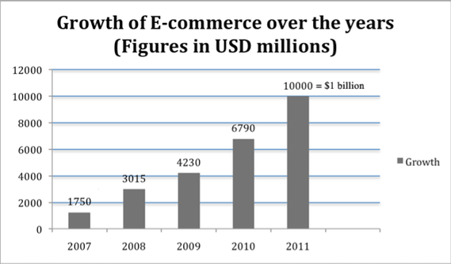
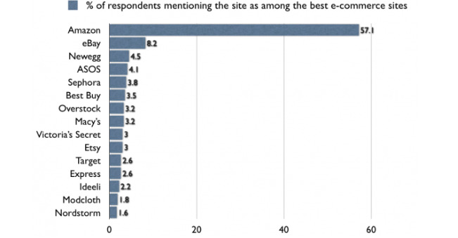
Motivation :
Online shopping has been a growing trend for over the past decade

Slide 6
Motivation cont’d :
Rich get richer concept, popular products get recommended more, while some products get lost in the Long Tail
Helps some of the amazing, yet not so popular products to reach the head
Different products and diverse options for users to choose from

Slide 7

Data Description [3]
Data Source:
Amazon product reviews: 1996 to 2014
Volume:
Metadata: 3.1Gb
Several categories combined: 12Gb containing 140 million reviews
Raw data feature set:
Metadata: productID, title, related, categories
Review data: reviewerID, productID, helpful, overall, summary, unixReviewTime
[3] http://www.an2software.com/website/images/data_abstraction_synch.png

Slide 8

Methods Proposed
Partitioning (Elbow method for finding the threshold)
Feature Engineering
EM Clustering
Predictive rating estimation models(Linear Regression, Maximum Likelihood Estimation)
KNN
Collaborative filtering (item-item)
[4]
[4] https://i-msdn.sec.s-msft.com/dynimg/IC848332.jpeg
Notes:
Works for categorical data as well

Slide 9
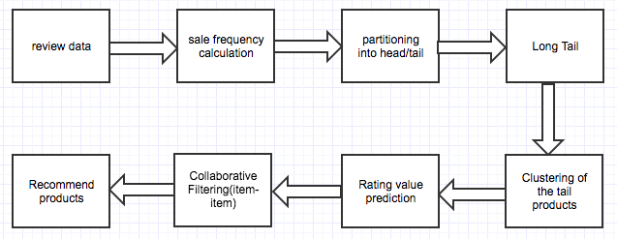
Workflow

Slide 10
Specific Experiments and Analysis
Tools used:
Spark’s machine learning library: MLlib
Visualization- scikit and pandas
Analysis:
Text mining & Frequent items
Calculate derived features from review data and find the distribution and type of products which fall in long tail
Find out which category of products have more items in long tail
EM Clustering
Find out if clustering of tail products provides better rating prediction
Recommendation
Use KNN to find out which long tail products per user get recommended

Slide 11
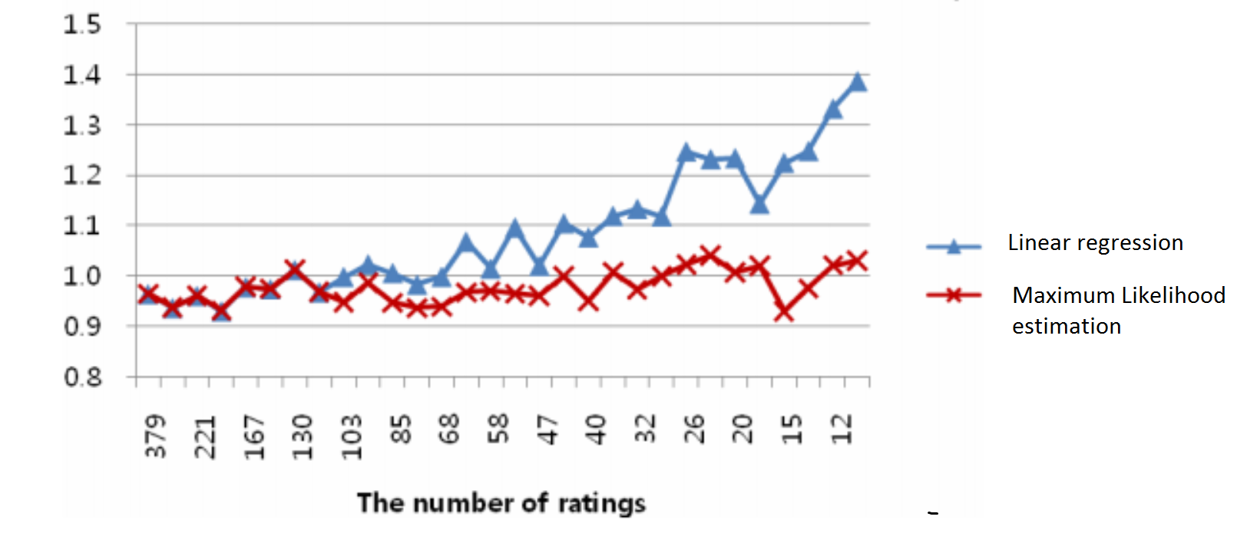
Mock-up or Preliminary Results
RMSE:

Slide 12

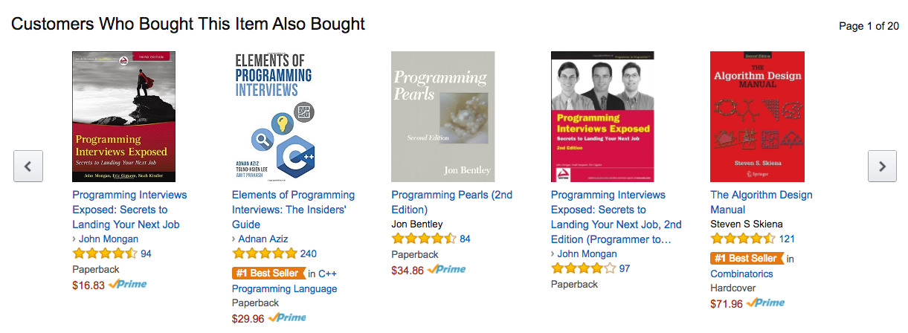
Mock-up or Preliminary Results cont’d

Slide 13
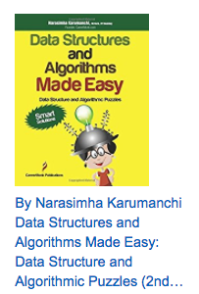
Mock-up or Preliminary Results Cont’d

Slide 14

Team Work
Team members and their tasks:
All the team members were involved in the initial discussion and scoping of the topic
Data preparation and long tail calculation: All the members
Dimensionality reduction and clustering: Anvika
Similarity calculation: Nipun
Collaborative filtering: Rakesh
Recommend: Sudeshna
http://aib.edu.au/blog/wp-content/uploads/2014/05/shutterstock_1474801791.jpg

Slide 15
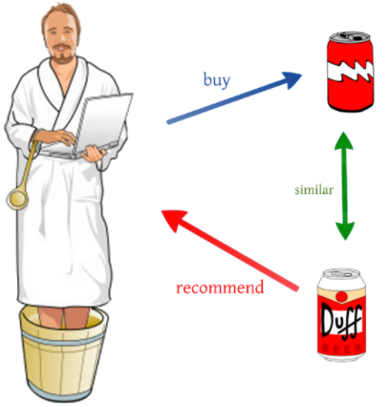
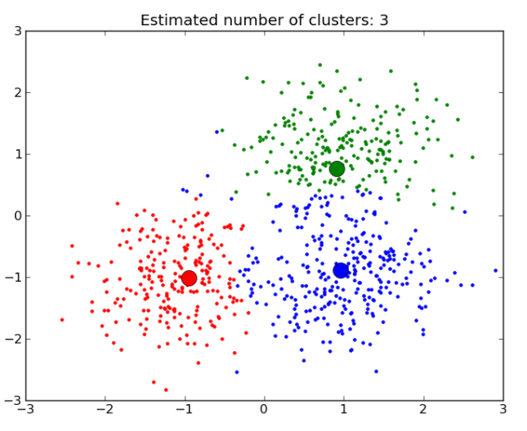

Summary of Course Concepts
Analytics: Clustering, Recommendation Systems, Collaborative Filtering
Data pipeline: Spark

Slide 16
Conclusion
The Amazon product dataset gives us an insight into what users think while buying product
Recommend products that are in the long tail to people based on their reviews and earlier choices made
Allows users to choose from a diverse range of products
In the process, find some interesting facts about products based on the given data

Slide 17
References
http://infolab.stanford.edu/~ullman/mmds/ch9.pdf
http://jmcauley.ucsd.edu/data/amazon/
The Long Tail of Recommender Systems and How to Leverage It
https://www.researchgate.net/profile/Diego_Peluffo/publication/286926602/figure/fig1/AS:306935011266560@1450190417862/Figure-1-Dimensionality-reduction-effect-over-a-Swiss-roll-manifold-Resultant-embedded.png
http://dataconomy.com/an-introduction-to-recommendation-engines/
https://i-msdn.sec.s-msft.com/dynimg/IC848332.jpeg
http://www.dataschool.io/content/images/2015/01/confusion_matrix2.png

Slide 18


Slide 19


